Slide 1
Relational Algebra
Lecture # 3B
Imran Siddiqi
imran.siddiqi@mcs.edu.pk
Computer Science Department
College of Telecommunication Engineering
National University of Sciences and Technology

Slide 2
Contents
Query Languages
Relational Algebra
  Basic Operations
  Additional Operations

Slide 3
Query Languages
Language in which user requests information from the database.
Categories of languages
  Procedural – ‘What & How’
  Non-procedural – ‘What’
“Pure” languages:
  Relational Algebra
  Tuple Relational Calculus
  Domain Relational Calculus
Pure languages form underlying basis of query languages that people use.

Slide 4
Relation Algebra
Relational algebra (RA) is a query language associated with the relational model
Core set of operators:
  Selection, projection, cross product, union, difference, and renaming
Additional, derived operators:
  Join, natural join, division, etc.

Slide 5
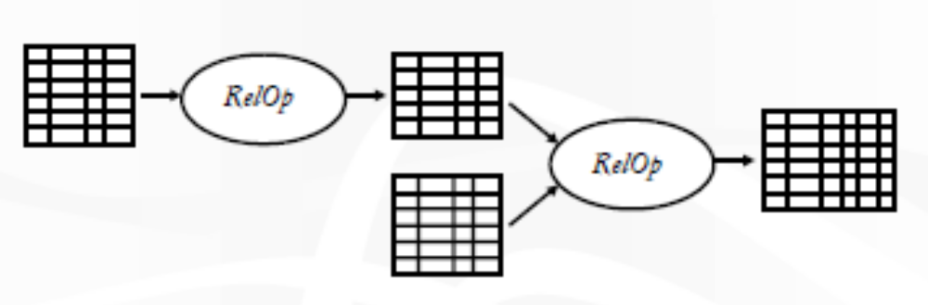
Relation Algebra
Every operator in RA takes one or two relations as parameters and return a relation
A unary algebra operator applied to a single relation
A binary algebra operator applied to two relations

Slide 6
The Select Operation
Input: a relation R
Notation: σ_{p} (R)
p is called a selection condition/predicate
Purpose: filter rows according to some criteria
Output: same columns as R, but only rows of R that satisfy p

Slide 7
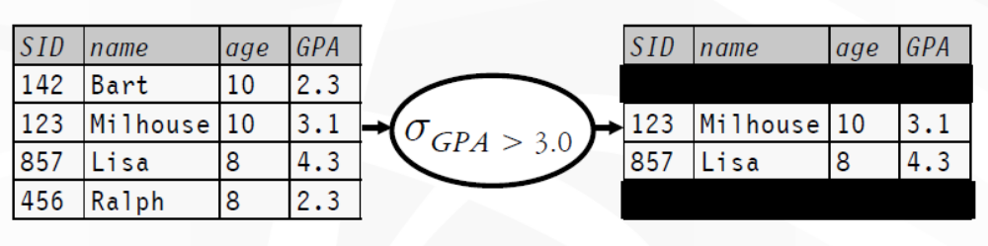

The Select Operation
Example
  Students with GPA greater than 3.0
σ_{GPA>3.0} (Student)
Student
The predicate is a Boolean expression: <,>,=, ≠,≤,≥,

Slide 8

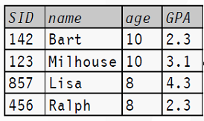
The Select Operation
Find students with A grades under 18 or over 21
σGPA≥4.0 (age < 18 V age > 21) (Student)
Student

Slide 9
The Project Operation
Input: a relation R
Notation: π_{L}( R )
L is a list of columns in R
Purpose: select columns to output
Output: same rows, but only the columns in L
Duplicate rows removed from result, since relations are sets

Slide 10
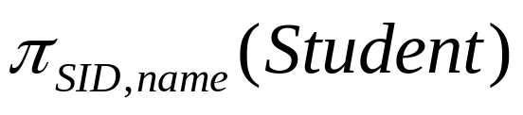
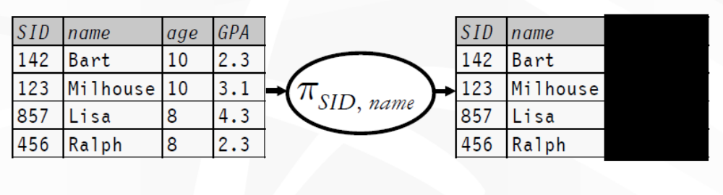
The Project Operation
IDs and Names of all Students

Slide 11
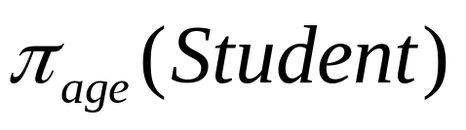
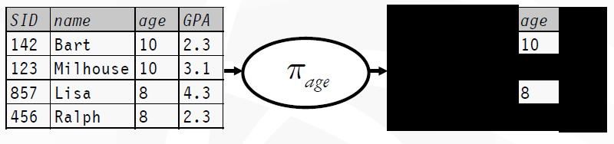
The Project Operation
Duplicate output rows are removed

Slide 12
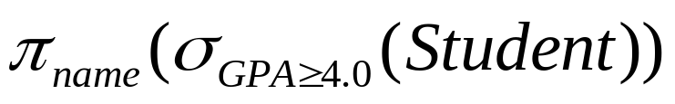
Combining Select and Project
Find the names of the students with A grades
Student
Output ???

Slide 13
Union
Input: two relations R and S
Notation: R U S
R and S are union compatible if:
  They have the same number of fields
  The corresponding fields have the same domains
Output:
  Has the same schema as R and S
  Contains all rows in R and all rows in S, with duplicates eliminated

Slide 14
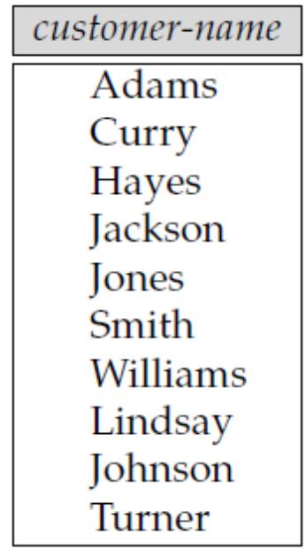
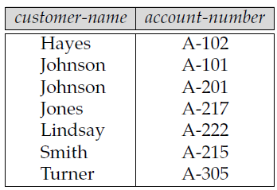
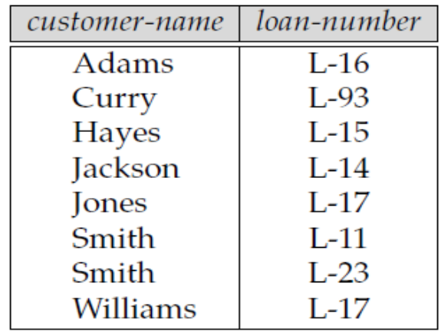
Union
Depositor
Borrower
Bank customers having either an account or a loan or both

Slide 15
The Set Difference Operation
Input: two relations R and S
Notation: R − S
R and S must be union compatible
Output:
  Has the same schema as R and S
  Contains all rows in R that are not found in S

Slide 16
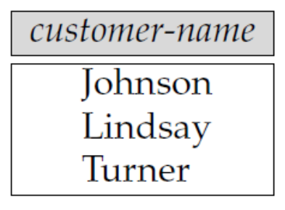
The Set Difference Operation
Depositor
Borrower
Bank customers having an account but not a loan

Slide 17

The Cartesian Product Operation
Input: two relations R and S
Notation: R × S
R × S returns a relation instance whose schema contains all fields of R (in the same order as in R) followed by all the fields in S (in the same order as in S)
The result contains one tuple (r,s) (concatenation of tuples r and s) for each pair of tuples

Slide 18
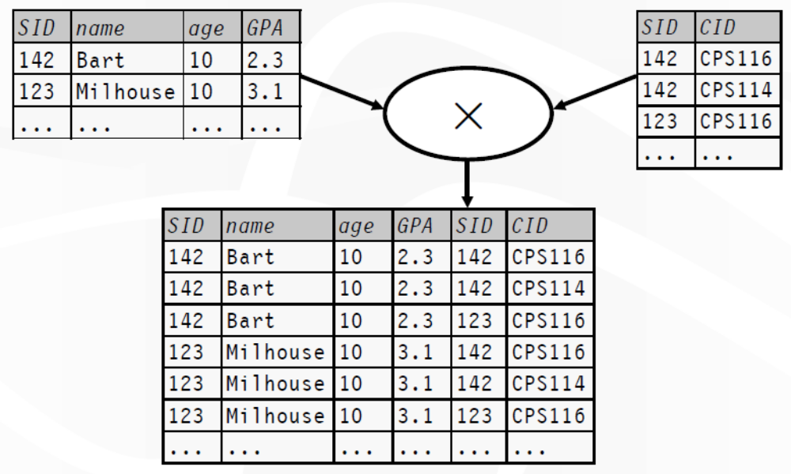
The Cartesian Product Operation
Students
Enrolls
Students x Enrolls
r=Students x Enrolls
For some tuples t in r:
t[Student.SID]≠ t[Enrolls.SID]

Slide 19
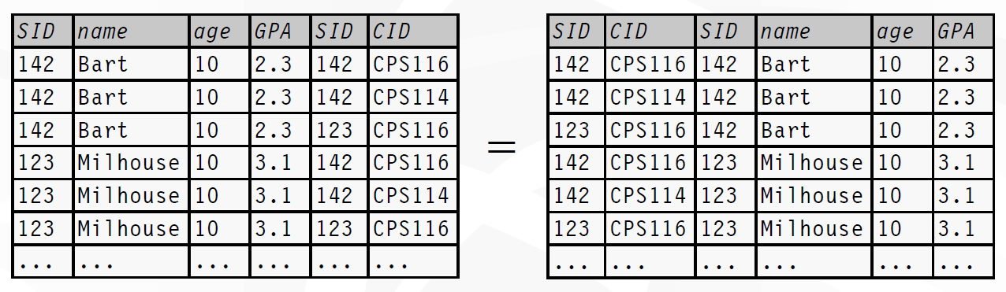
The Cartesian Product Operation
The ordering of columns in a table is considered unimportant (so is the ordering of rows)
The cross product is commutative, i.e. R × S = S × R for any R and S

Slide 20
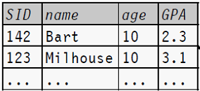
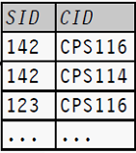
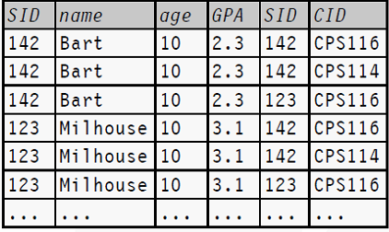

The Cartesian Product Operation
Students
Enrolls
Find the names of students enrolled in CPS114
Students x Enrolls

Slide 21

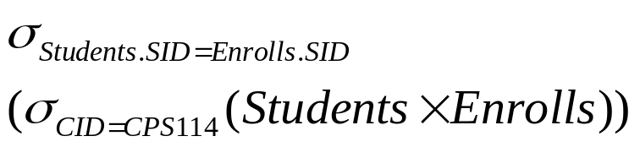
The Cartesian Product Operation
Students
Enrolls
Find the names of students enrolled in CPS114
Students x Enrolls

Slide 22
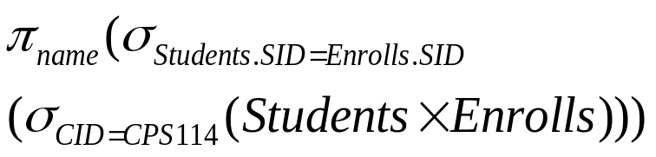
The Cartesian Product Operation
Students
Enrolls
Find the names of students enrolled in CPS114
Students x Enrolls

Slide 23
The Rename Operation
Input: a relation R
Notation: ρ_{X} ( R ), or ρ_{X(A1, A2, …)} ( R )
Purpose: Rename a table and/or its columns
Used to
  Avoid confusion caused by identical column names
Example
  ρ_{X} ( R ), returns the expression R under the name X
  ρ_{X(A1, A2, …)} ( R ) returns the result of expression R under the name X, and with the attributes renamed to A1, A2, …., An

Slide 24
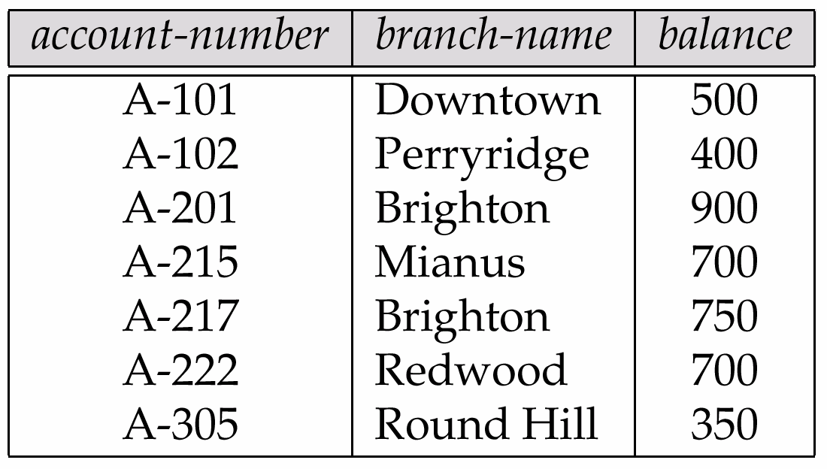
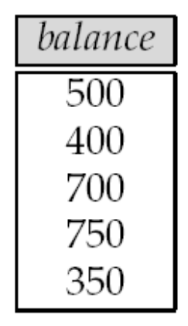
The Rename Operation
Accounts
Find the largest account balance in the bank
To compare the balances, we need to compute the product account x account

Slide 25
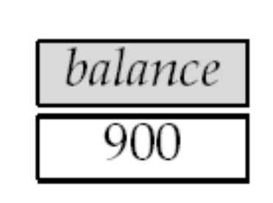
The Rename Operation
Accounts
Find the largest account balance in the bank

Slide 26
Formal Definition
A basic expression in the relational algebra consists of either one of the following:
  A relation in the database
  A constant relation
Let E₁ and E₂ be relational-algebra expressions; the following are all relational-algebra expressions:
  E₁ ∪ E₂
  E₁ - E₂
  E₁ x E₂
  σ_{p} (E₁), P is a predicate on attributes in E₁
  ∏_{s}(E₁), S is a list consisting of some of the attributes in E₁
  ρ _{x} (E₁), x is the new name for the result of E₁

Slide 27
Additional Operations
The additional/derived operations do not add any power to the relational algebra, but they simplify common queries
  Set intersection
  Natural join
  Division
  Assignment

Slide 28
The Set Intersection Operation
Input: two relations R and S
Notation: R ∩ S
R and S must have identical schema
Output:
  Has the same schema as R and S
  Contains all rows that are in both R and S
Shorthand for R − ( R − S )

Slide 29
The Set Intersection Operation
Depositor
Borrower
Find all the customers having both an account and a loan

Slide 30
The Join Operations
The join operation is the most useful operation in relational algebra
It can be defined with cross product followed by selections and projections
There exist several variants of joins:
  Condition Join
  Equijoin
  Natural Join

Slide 31
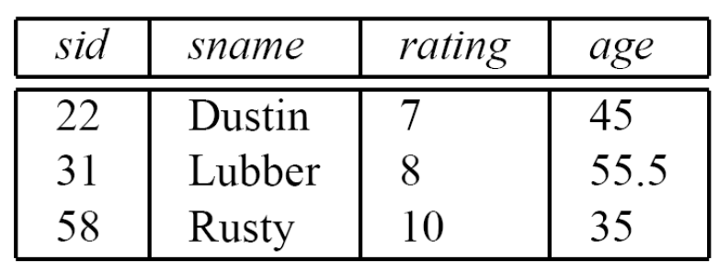
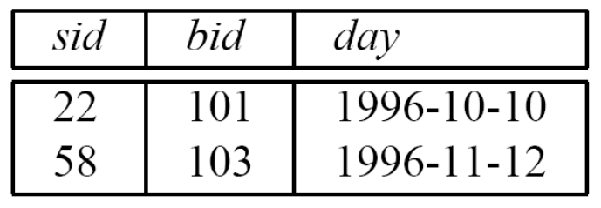
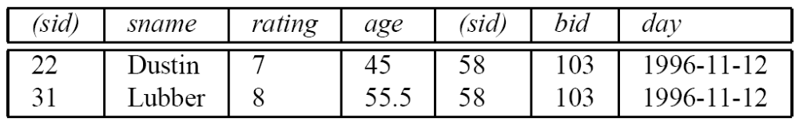
Condition Joins
Essentially, a select of a cross product:
R
S
= σ_{c} (R x S)
C
S
R
R
S
S.sid < R.sid

Slide 32
Equijoin
A special case of join when the join condition consists only of a conjunction of equalities of the form R.name1 = S.name2
There is redundancy in keeping both attributes (as they have the same value) in the relation, so S.name2 is dropped
R
S
S.sid = R.sid

Slide 33
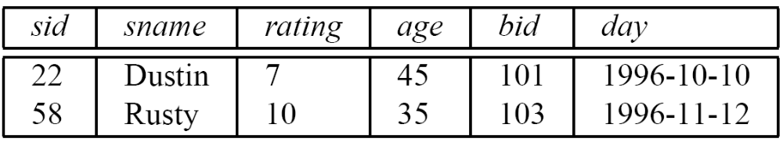
Equijoin
S
R
R
S
S.sid = R.sid

Slide 34
Natural Join
A natural join is a equijoin in which equalities are specified on all fields that have the same name
In this case we simply omit the condition
The result does not have repeated field names
R
S =
R
S
S.sid = R.sid
If the two relations have no common attributes, then, the result is the cross product
The previous example of Equijoin was in fact a Natural Join

Slide 35
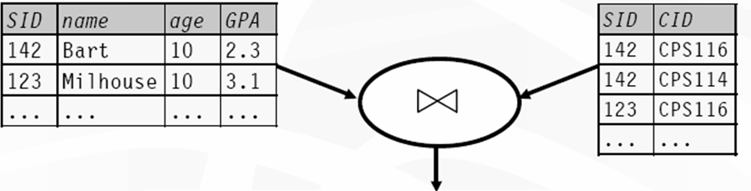
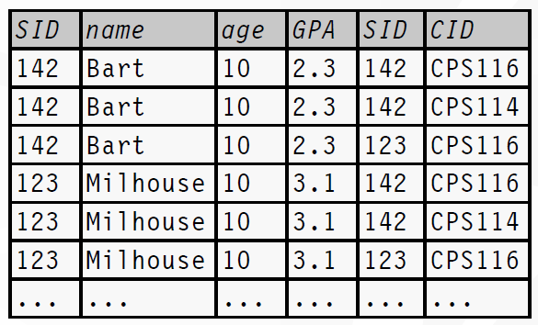
Natural Join

Slide 36
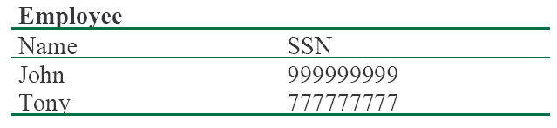
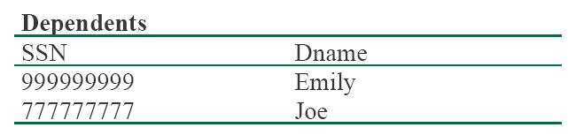

Natural Join

Slide 37
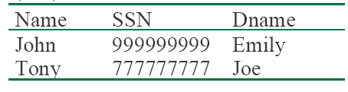
Natural Join

Slide 38
Natural Join
Question 1
Given the schemas R(A,B,C,D), S(A,C,E), what is the schema of R S?
Answer
  Result schema = (A, B, C, D, E)

Slide 39
Natural Join
Question 2
Given the schemas R(A,B,C), S(D,E), what is R S?
Answer
  R S = R x S

Slide 40
Natural Join
Question 3
Given the schemas R(A,B), S(A,B), what is R S?
Answer
  Result schema (A,B)
  And the output is: ….

Slide 41
Natural Join : Summary
  R = (A, B, C, D)
  S = (E, B, D)
  Result schema = (A, B, C, D, E)
  r s is defined as:
∏_{r.A, r.B, r.C, r.D, s.E} (σ_{r.B = s.B ∧ r.D = s.D} (r x s))

Slide 42
The Divide Operation
It is a complex operator
Useful in situations such as: find the students who are enrolled in all the courses
Two relation instances A and B
A has two fields: x,y
B has only one field: y
For each x value in A, consider the y values that appear in tuples of A with that x value. If this set contains all values in B, the x value is in the result of A÷B

Slide 43
The Divide Operation
If r and s are relations on schemas R and S respectively where
  R = (A₁, …, A_{m}, B₁, …, B_{n})
  S = (B₁, …, B_{n})
  The result of r ÷ s is a relation on schema
  R – S = (A₁, …, A_{m})

Slide 44
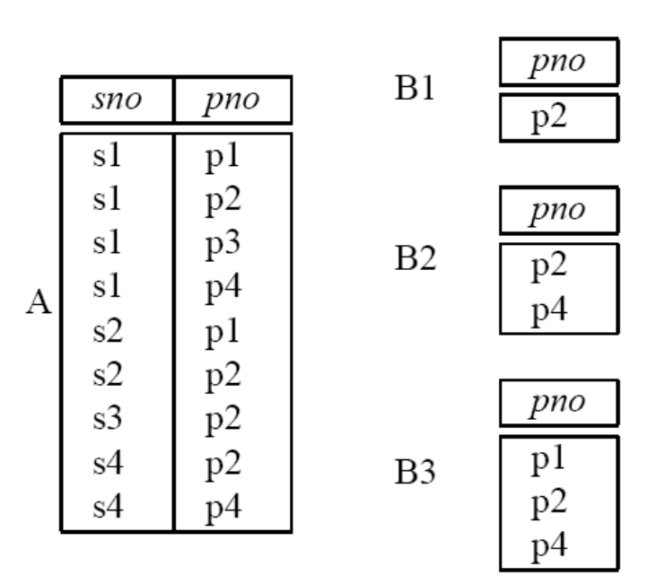
The Divide Operation
B_{i} are parts
A are the suppliers and the parts they supply
A÷B_{i} are those suppliers who supply all parts listed in B_{i}

Slide 45
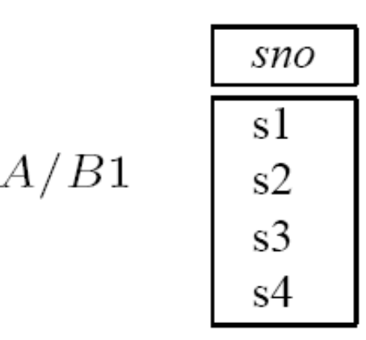
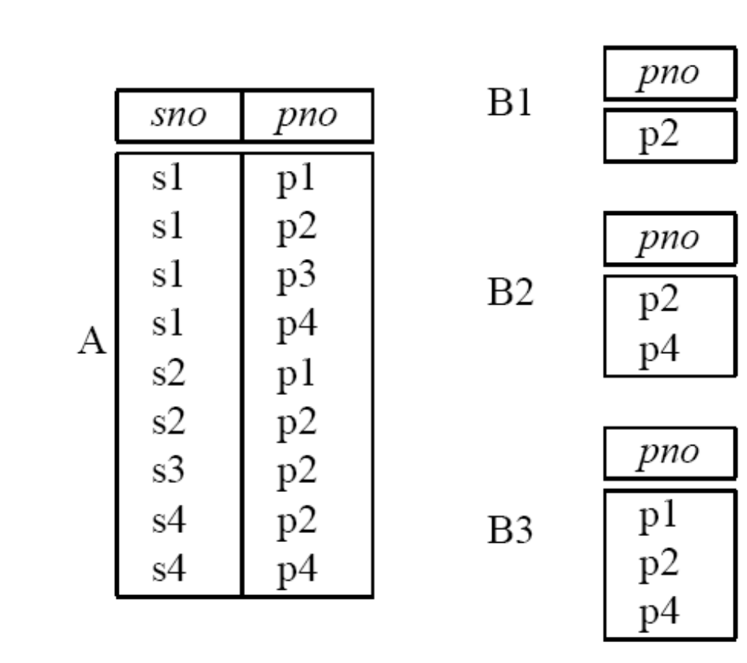
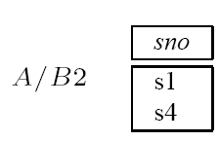
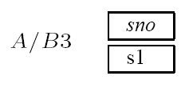
The Divide Operation

Slide 46
The Division Operation
Definition in terms of the basic algebra operation
Let r(R) and s(S) be relations, and let S ⊆ R
r ÷ s = ∏_{R-S} (r) –∏_{R-S} ( (∏_{R-S} (r) x s) – ∏_{R-S,S}(r))
Convince yourself with an example

Slide 47
The Assignment Operation
r ÷ s = ∏_{R-S} (r) –∏_{R-S} ( (∏_{R-S} (r) x s) – ∏_{R-S,S}(r))
The assignment operation (←) provides a convenient way to express complex queries.
  Write query as a sequential program consisting of
    A series of assignments
    Followed by an expression whose value is displayed as a result of the query.
  Assignment must always be made to a temporary relation variable.
Example: Write r ÷ s as
temp1 ← ∏_{R-S} (r)
temp2 ← ∏_{R-S} ((temp1 x s) – ∏_{R-S,S} (r))
result = temp1 – temp2
  The result to the right of the ← is assigned to the relation variable on the left of the ←.
  May use variable in subsequent expressions

Slide 48
References
Chapter 3, Database System Concepts, Silberschatz, Korth, Sudarshan

